Slide 1
Evaluation of Hyperparameter Tunability in Statistical Machine Learning
Yuhsiang (Sean) Hong

Slide 2
Approach
Grid Search The search space of Grid Search for each hyperparameter is discretized in a fixed search space. The algorithm launches a learning process for each of the hyperparameter configurations and selects the best at the end.
Random Search Random search is a technique where random combinations of the hyperparameters are used to find the best solution for the built model. It is similar to grid search, and yet it has proven to yield better results.
Bayesian Optimization Bayesian Optimization is a Sequential Model-Based Optimization (SMBO) method. It works by building a probabilistic model of the objective function, called the surrogate function, and then searched with an acquisition function before candidate samples are chosen for evaluation on the real objective function.

Slide 3
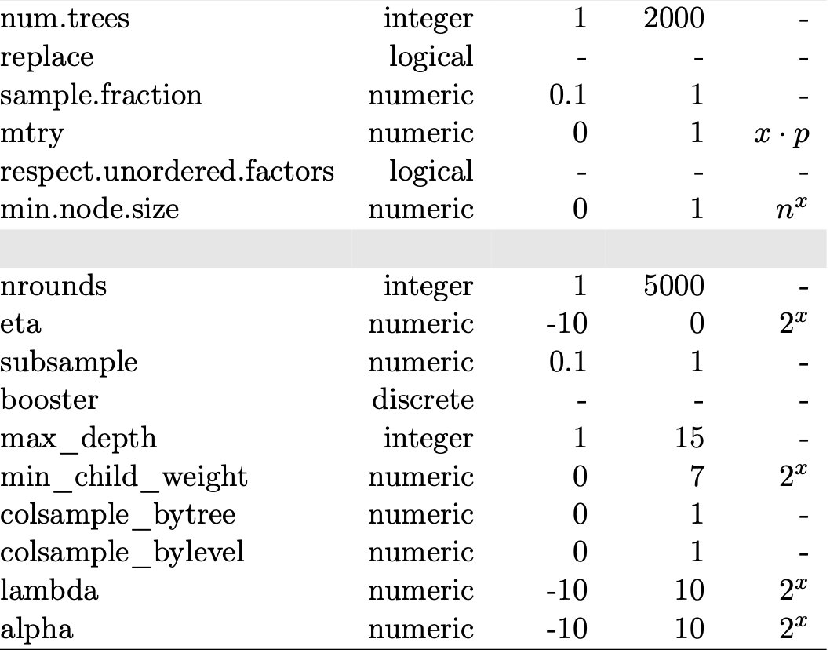
Workflow
Construct simulation datasets Friedman datasets from “mlbench” package in R: mlbench.friedman1(n = 50, sd). The selected noises are {0.1, 0.2, 0.4, 0.6, 0.8, 1.0}.
Determine the evaluation criteria Regression: Mean Squared Error(MSE), Root-Mean-Squared-Error(RMSE), R-squared score(R^2).
Constrain hyperparameter space on which the tuning should be executed

Slide 4
Workflow
ranger
num.trees | 500
replace | TRUE
sample.fraction | 1
mtry | 3
min.node.size | 5
Select the hyperparameters for tuning Random Forest(ranger): num.trees, replace, sample.fraction, mtry, min.node.size, respect.unordered.factors Gradient boost(xgboost): nrounds, booster, lambda, alpha, eta, subsample, max_depth, min_child_weight, colsample_bytree, colsample_bylevel
Run the machine learning algorithms using the default values in the functions 1. If there are no default values for the parameters in the function, we will select the values by ourselves. 2. Compare the prediction errors (MSE of testing datasets) between two algorithms.
xgboost
nrounds | 2
booster | gbtree
lambda | 0
alpha | 0
eta | 0.3
subsample | 1
max_depth | 6
min_child_weight | 1

Slide 5
Workflow
Set up tuning functions 1. Fit a surrogate model with the evaluation measures (MSE or RMSE) as the dependent variable and the hyperparameters as independent variables. 2. Find the set of hyperparameter values that maximize the Expected Improvement. Hand this hyperparameter combination to the objective function for evaluation and retrieve the corresponding score. 3. Update the surrogate function along the feedback of the objective function by applying Bayes’ theorem.
Packages for tuning in R Although we can code the tuning functions by ourselves, there are also some packages in R that we can easily use to tune the hyperparameters such as “mlrMBO” and so on.
Use the optimized hyperparameters on testing datasets and compare the outcomes

Slide 6
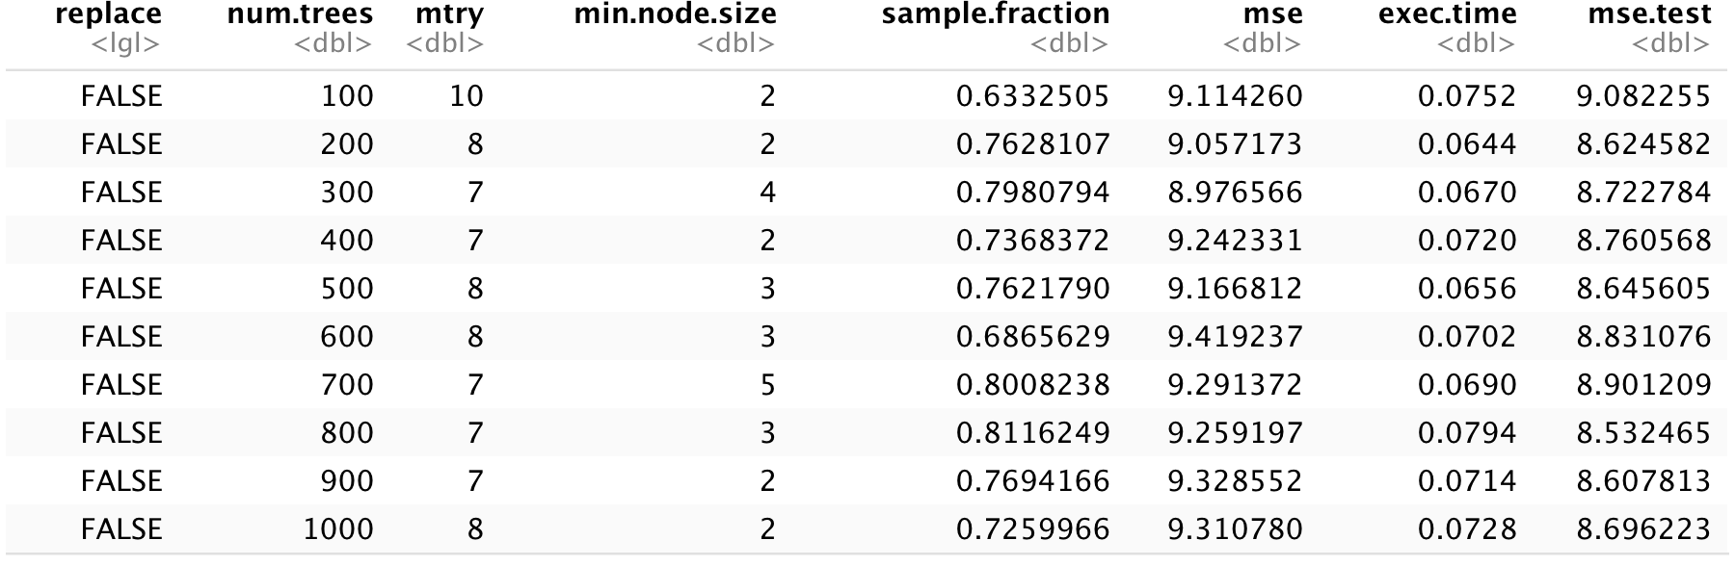

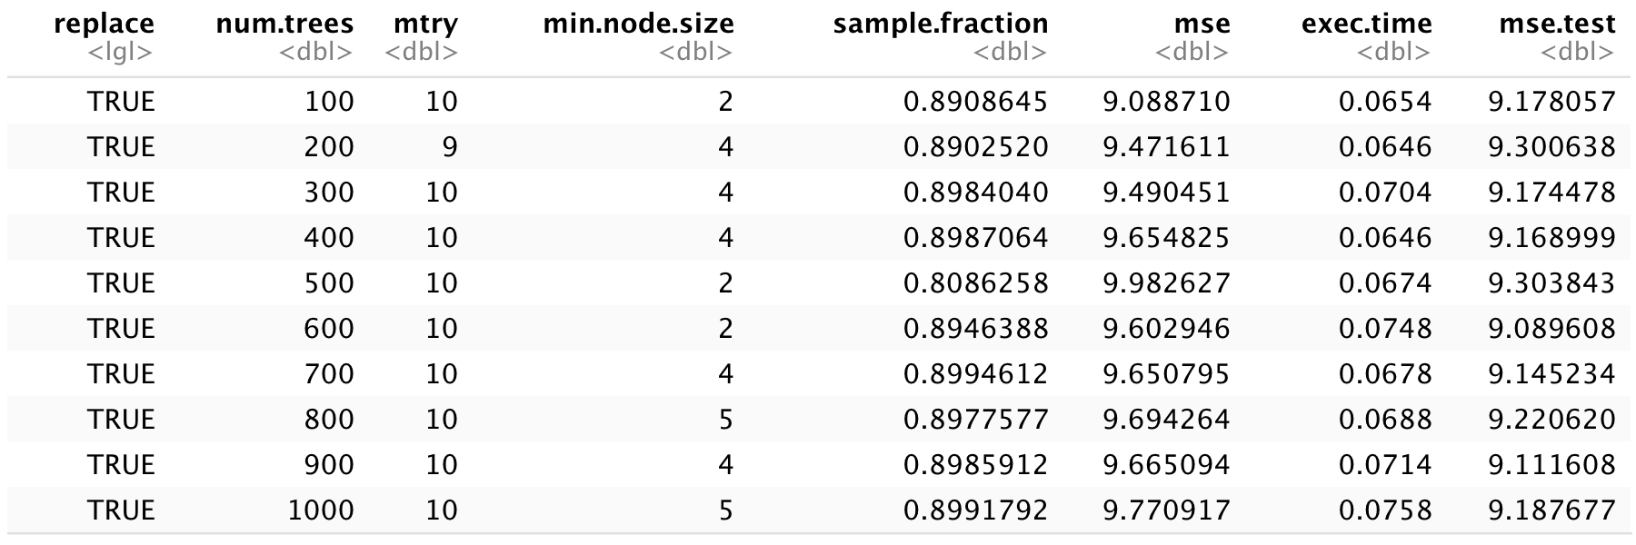
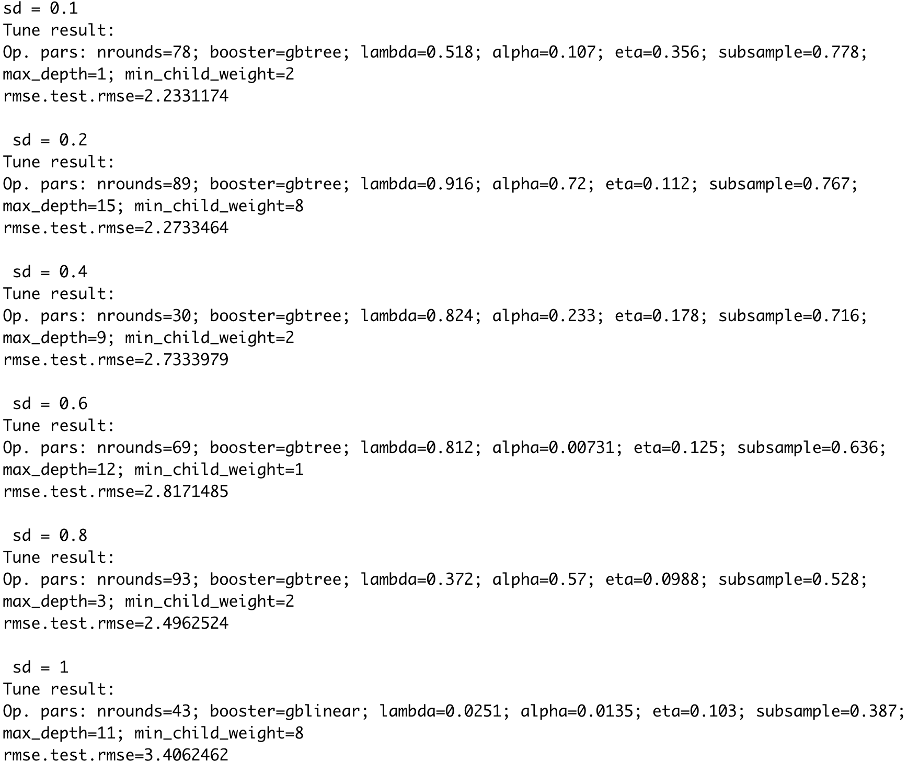
Result
Random Forest
Gradient Boost

Slide 7
Future Approach
Create more datasets
Determine which hyperparameters are important to tune
Random Search
Find optimal default values of hyperparameters for the algorithms among different datasets
Visualize the outcomes from different datasets and algorithms

Slide 8
The End

